Slide 1
The Developer’s Dream
Maintainable and dynamic extensions in Liferay 7
November 2015
Raymond Augé
Sr. Software Architect

Slide 2
Full lifecycle! ♻
coding
compiling
assembling
testing
executing
debugging
Notes:
Any software maintenance cycle encompasses; coding, compiling, assembling, testing, executing, debugging.
If any of these is missing or flawed the lifecycle of software will be severely restricted.

Slide 3
Easy to Create! 👊
plain old Jars
Notes:
The first wish is for development to be simple and easy.
If it's too hard, frustration sets in and we quickly move to doubt and anger.
Plain old jars are the basic modular unit so it should be most familiar to every java developer.

Slide 4
Concise and easy to understand! 👌
less boilerplate code
fewer descriptors
Notes:
We want modules to be easy to understand and reflect actual business logic.
The reality is that programs should lend themselves to being handed off to other developers since this is simply a nature of the industry.
This means concise, well documented and well tested modules. (If the last two can't easily be achieved at VERY least make the code small enough so as to fit into the average developer's brain.)

Slide 5
Decoupled! 💑
contracts
contracts
contracts
Notes:
Decoupling means that things work rather better together because communication is well defined in a contract.
It means understanding does not require reviewing the entire set of all implementations.
It means easier testing.
It means substitutability.
It means sanity.

Slide 6
Versioning! ≠
semantic versioning is critical
Notes:
Contracts are hard (even impossible) to maintain over time without versioning.
Semantic versioning is critical for sane software evolution.

Slide 7
Services! 🚈
implied risk
cornerstone of reactive programing
Notes:
To base collaboration and interactions on services means that runtimes are better equipped to deal with periods of volatility, dynamicity and recomposition.
Programming services forces a developer’s to acknowledge the risks dependencies carry which leads to better software.
I believe service based development is a cornerstone of the reactive programming model because adjusting to environmental conditions is hard when software can’t evolve dynamically.
Frameworks based on services can be made to easily react to environmental conditions fulfilling the principles of reactive systems.

Slide 8
Elements of Liferay 7 extensions! 📌
OSGi
core framework
cmpn/ee specifications
open source implementations
Notes:
OSGi is the primary technology on which Liferay 7 extensions are implemented.
In addition to the core framework, several specific specifications are leveraged heavily.
All implementations are open source, including everything built by Liferay.

Slide 9
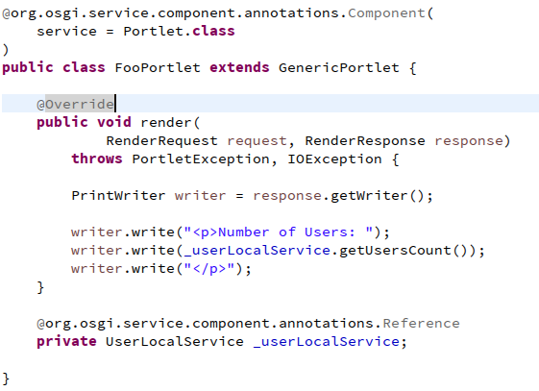
DS (Declarative Services)! 💪
OSGi Compendium
§ 112, Version 1.3
component
framework
Notes:
Pojos, annotations, services, references, configuration ... You can't go wrong with DS.
In my opinion other component framework choices require very specific reasoning.
Your first choice should be DS.
It should cover 80-90% of use cases.

Slide 10
Configuration! 🔧
hard to get it right
Notes:
By far the hardest part of complex programming, outside of business logic, is (re)configuration.
Getting configuration right is extremely hard.

Slide 11
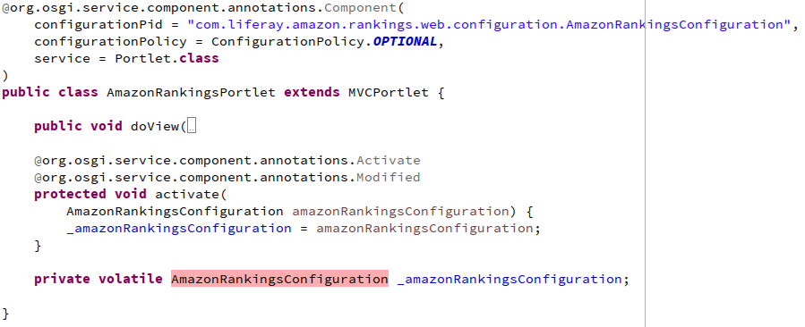
CM (Configuration Admin)! 👍
OSGi Compendium
§ 104, Version 1.5
configuration
management
Notes:
Luckily there is CM.
I can’t think of any reasons not to use it.

Slide 12
Configuration Schema! 📃
contracts
contracts
contracts
Notes:
Since we want to work with contracts, it also makes sense that configuration also be defined by contracts.

Slide 13
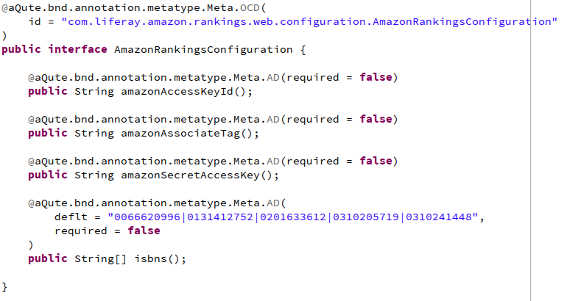
Metatype! 👏
OSGi Compendium
§ 105, Version 1.3
schema for
configuration
Notes:
Metatype defines schema we can use to enforce configuration contracts.

Slide 14
Web! 🌐
servlets
filters
listeners
Notes:
Of course we are largely programing for the web and so we need support for it.

Slide 15
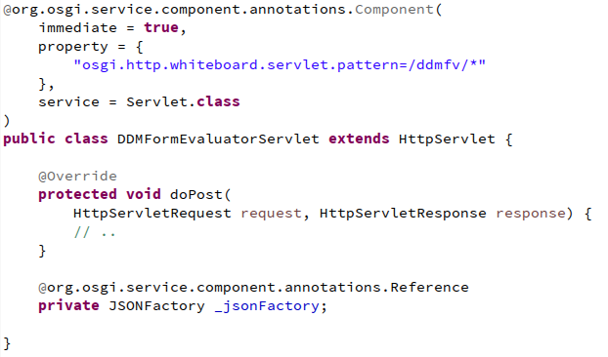
Http Whiteboard! 📝
OSGi Compendium
§ 140, Version 1.0
traditional web
programming
but with services
Notes:
Http Whiteboard provides an ideal and simple model for providing web support without the bloat of full blown web apps.
It allows for a web application composition model which is long overdue.

Slide 16
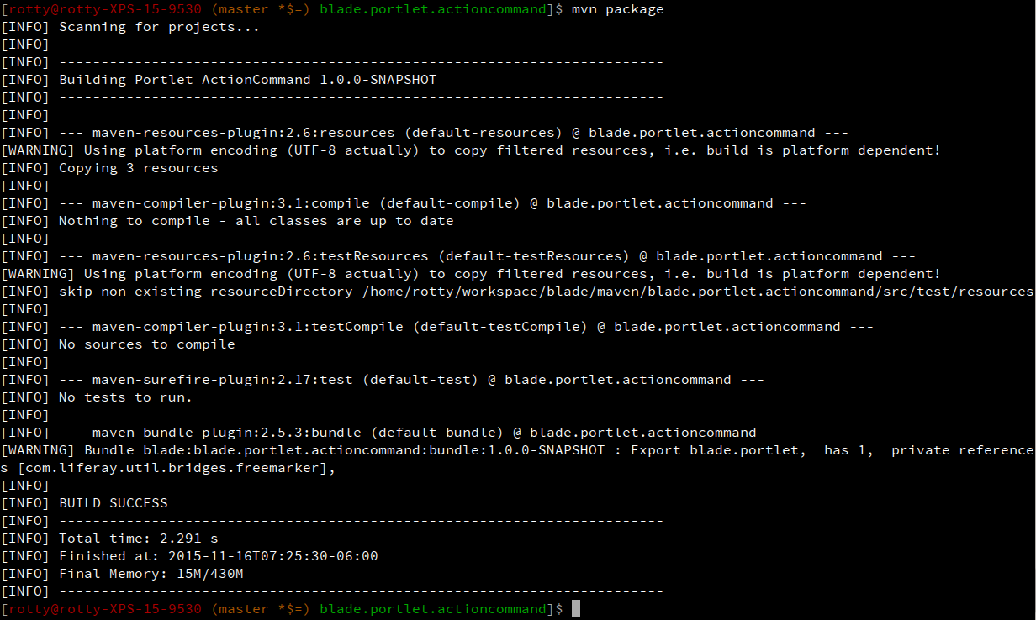
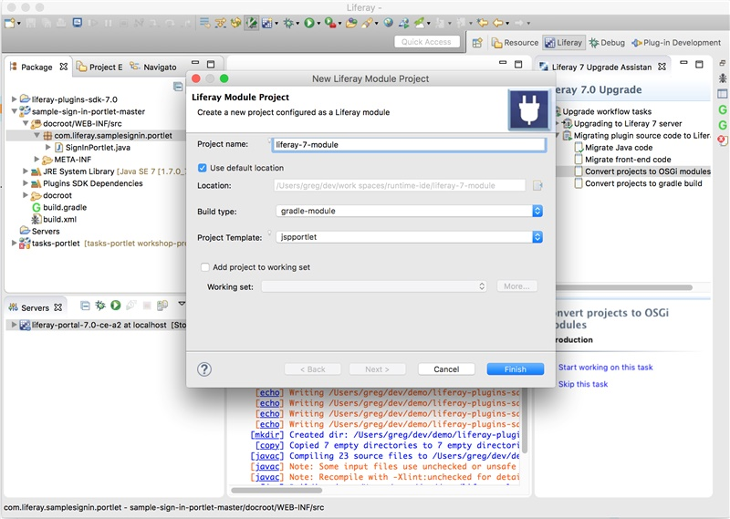
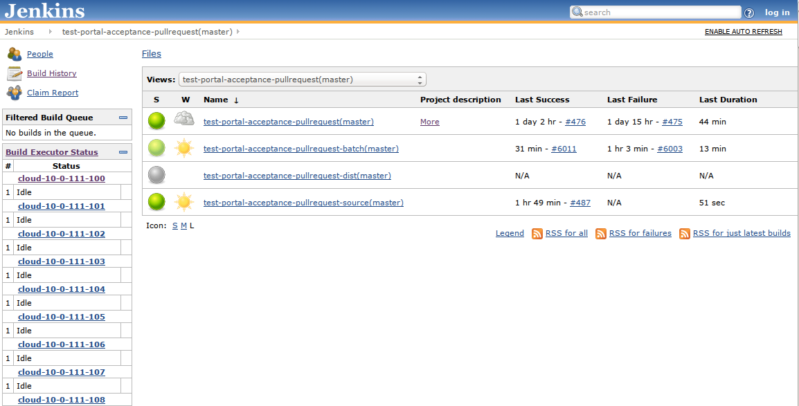
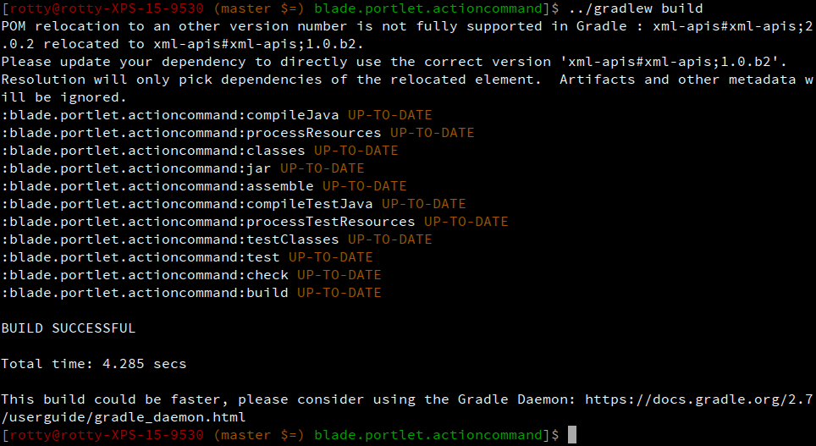
Tooling! 🔨
IDEs
builds
CI
Notes:
It's fine to talk about all these interesting technologies. But without the tools to maintain them, the discussion is moot.
Today maven and gradle are the preferred build tools and a lot of effort is being put into ensuring it's possible to build properly modular software with them.
Liferay is of course expanding its Eclipse based Liferay IDE to support all the new aspects of modular extensions and even providing some very interesting tools to help migrate legacy extensions/plugins to this new model.

Slide 17
Thank you!

